Slide 1




ATLIQ HARDWARE
CONSUMER GOODS
AD-HOC ANALYSIS
Presented By : Kanchan Sinha

Slide 2


CONTENT
01
02
03
Company Overview
Business Model
Problem Statement
04
05
06
Objective
Analysis
Insights

Slide 3




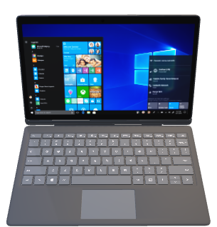
ABOUT US
AtliQ Hardware is a global supplier specializing in computers and their peripherals. The company is committed to providing high-quality hardware solutions that enhance productivity and user experience

Slide 4



Platform Presence
Brick & Mortar
E- commerce

Slide 5






Distribution Channel
Neptune
e Store
exclusive
Retailer
Direct
Distributor

Slide 6




Problem Statement
AtliQ Hardware is struggling to quickly address specific business questions due to the limitations of its current reporting tool.
This delays timely, data-driven decisions in areas like sales, finance, and inventory.
The data analyst team has received 10 ad-hoc requests for SQL-based analyses to provide timely insights for critical business decisions.

Slide 7




OBJECTIVES
Conduct SQL-based ad-hoc analyses to generate quick, actionable insights that address specific business questions and challenges.
These analyses will support data-driven decisions across key areas, including sales, finance, marketing, and supply chain, ultimately enhancing overall business performance and strategy.

Slide 8
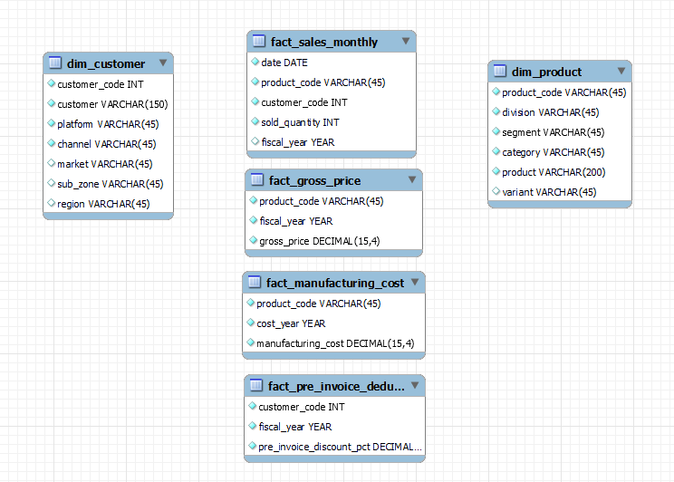
Database

Slide 9
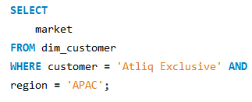
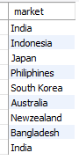

1. Provide the list of markets in which customer "Atliq Exclusive" operates its business in the APAC region.

Slide 10
Insights
Out of 17 markets for Atiq exclusive 9 are from APAC region.
A significant portion of Atiq Exclusive’s market is concentrated in the APAC region, indicating its importance in the company's overall strategy.
Recommendations
Potential to deepen market penetration and tailor strategies to APAC consumer preferences.
Understanding the diverse cultural and economic backgrounds of the APAC countries can aid in developing localized marketing strategies, enhancing brand acceptance and loyalty.

Slide 11
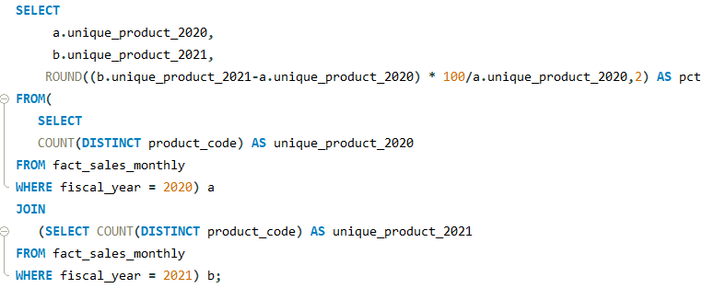
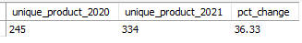
2. What is the percentage of unique product increase in 2021 vs. 2020? The final output contains these fields: unique_products_2020, unique_products_2021, percentage_change

Slide 12

Insights
The 36.3% increase in unique products may indicate that the company is investing in R&D and product innovation, leading to the introduction of new products to the market.
This could also suggest the company is expanding into new markets or targeting new customer segments with a broader product range.
36.3%

Slide 13
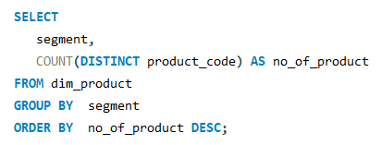
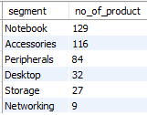
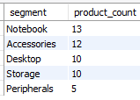
3. Provide a report with all the unique product counts for each segment and sort them in descending order of product counts. The final output contains: segment, product_count.
Unsold Products

Slide 14
Insights
The notebook is performing well in terms of both the number of products sold and gross sales.
Although there are only 9 unique networking products, they surpass desktops in terms of gross sales.

Slide 15
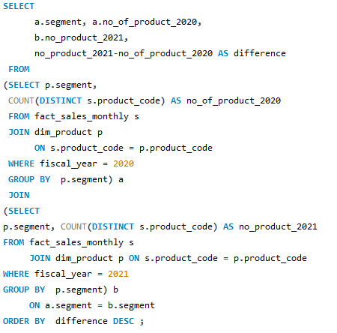
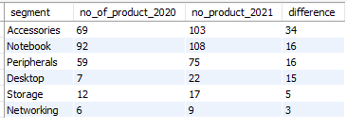
4. Follow-up: Which segment had the most increase in unique products in 2021 vs 2020? The final output contains these fields: segment, product_count_2020, product_count_2021, difference

Slide 16
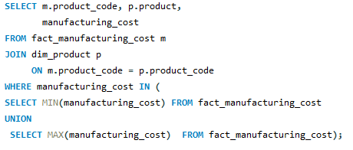
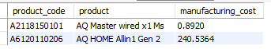
5. Get the products that have the highest and lowest manufacturing costs. The final output should contain these fields: product_code product, manufacturing_cost

Slide 17

AQ Master wired x1 MS
AQ HOME Allin1 Gen 2
Lowest Manufacturing Cost
Highest Manufacturing Cost

Slide 18
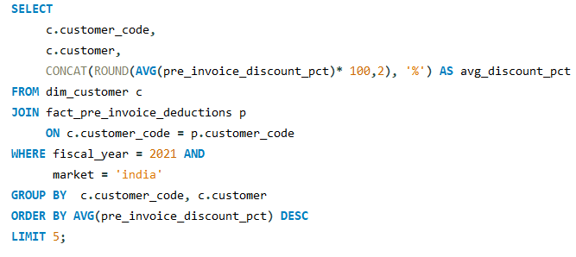
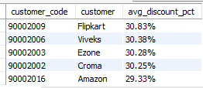
6. Generate a report which contains the top 5 customers who received an average high pre_invoice_discount_pct for the fiscal year 2021 and in the Indian market. The final output contains these field: customer_code, customer, average_discount_percentage.

Slide 19
Insights
The company giving almost equal discounts to its top 5 customers reflects a consistent and fair pricing strategy aimed at fostering strong relationships.
This approach also ensures competitiveness across both online and offline channels while driving sales volume.

Slide 20
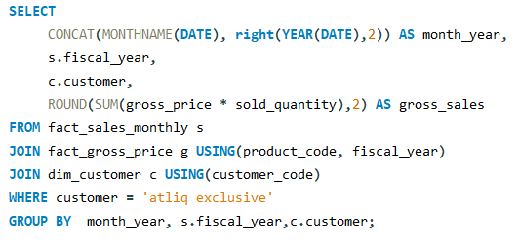
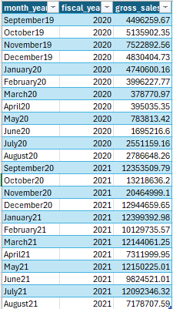
7. Get the complete report of the Gross sales amount for the customer “Atliq Exclusive” for each month. This analysis helps to get an idea of low and high-performing months and take strategic decisions. The final report contains these columns: Month, Year, Gross sales Amount

Slide 22
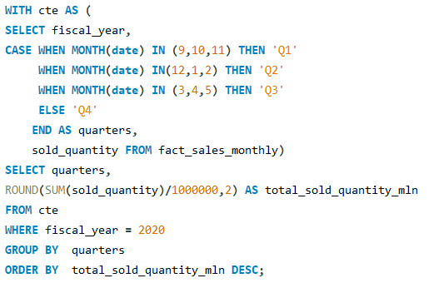
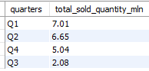
8. In which quarter of 2020, got the maximum total_sold_quantity? The final output contains these fields sorted by the total_sold_quantity, Quarter, total_sold_quantity.

Slide 23
8. In which quarter of 2020, got the maximum total_sold_quantity? The final output contains these fields sorted by the total_sold_quantity, Quarter, total_sold_quantity.

Slide 24
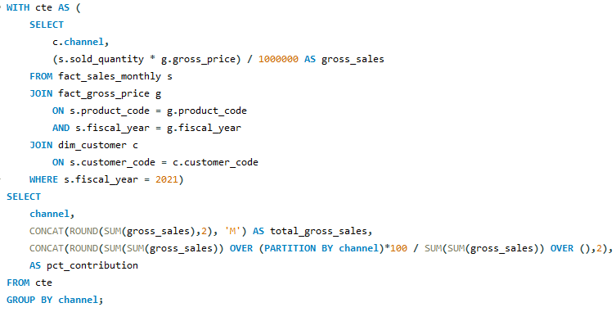
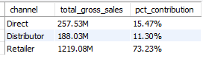
9. Which channel helped to bring more gross sales in the fiscal year 2021and the percentage of contribution? The final output contains these fields: channel, gross_sales_mln, percentage.

Slide 25
73.23%
15.47%
11.30%
Distributor
Direct
Retailer
Channel

Slide 26
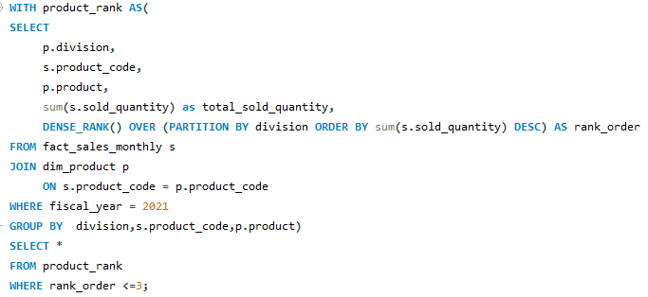
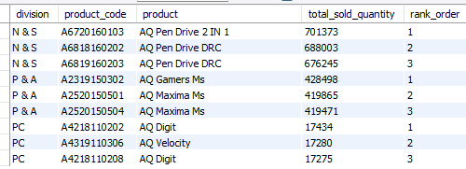
10. Get the Top 3 products in each division that have a high total_sold_quantity in the fiscal_year 2021? The final output contains these fields: division product_code, product, total_sold_quantity, rank_order.

Slide 27

Thank You
LinkedIn

